Slide 1
AGENTIC RAG
BY – BALA GOPAL REDDY PEDDIREDDY

Slide 2
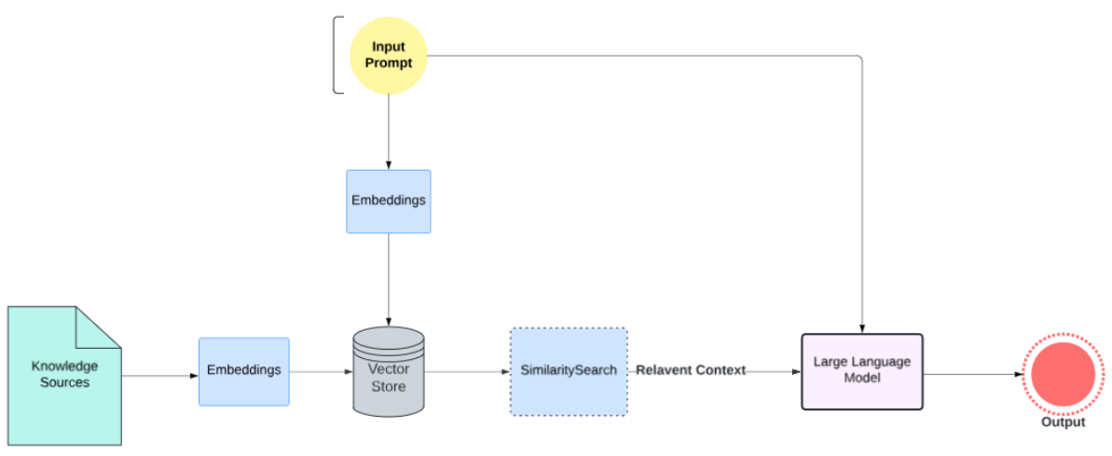
What is Naive RAG?

Slide 3
Recent developments
Advanced Retrieval Techniques
Efficient Semantic Caching
Integrated Multimodal Systems
Document-level vectorization
Hybrid search approaches
Reranking methods
Accelerated query responses
Minimized LLM utilization
Reliable response consistency
Broader data access
Enhanced image-text synergy

Slide 4
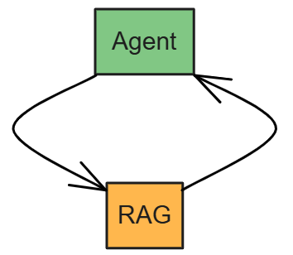

What is Agentic RAG?
Ex: Research Team

Slide 5

EXAMPLE
LIBRARY
“The impact of artificial intelligence on modern education and compare it over the years in terms of AI Utilization in daily life ?”
Question
USER

Slide 6


EXAMPLE
LIBRARY
MANAGER
Question
Answer
LIBRARIANS
USER
ANALYST
RESEARCHER
VERIFIER

Slide 7
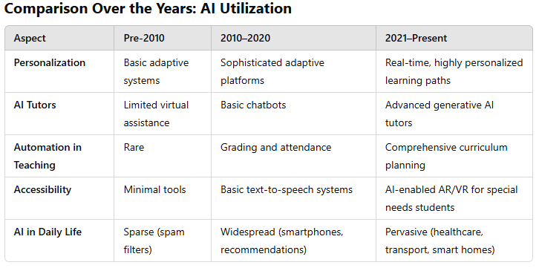
EXAMPLE
LIBRARY
“The impact of artificial intelligence on modern education and compare it over the years in terms of AI Utilization in daily life ?”
Question
Answer
USER

Slide 8
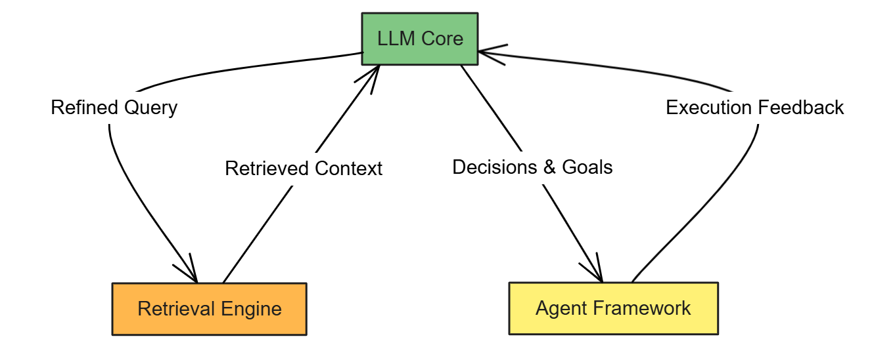
What is Agentic RAG?

Slide 9
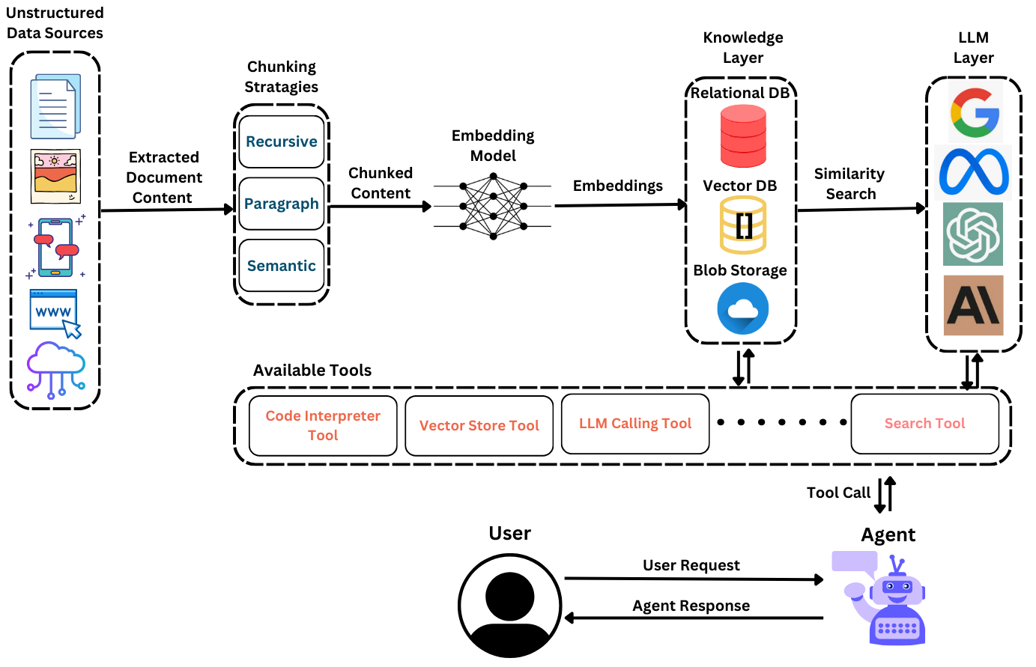
Agentic RAG ARCHITECTURE

Slide 10
Pros and Cons of Agentic RAG
FEATURES
Continuous Learning
Context-Aware Decision-Making
Customizability
Goal-Oriented
Tool Utilization and Flexibility
Challenges
Complexity
Resource Intensive
Error Propagation

Slide 11

THANK YOU

